Slide 1
LOW INCOME and
ELDERLY ASSISTANCE GRANTS
Blue Team:
Ari, Pam, Sophia, Teresa

Slide 2
Data Inclusions and Exclusions
We did not include outlying U.S. islands and properties, such as Puerto Rico and Guam, but we did include the District of Columbia when calculating our figures.
Most currency figures are rounded to two decimals, as well as percentages.
Focused on ratios as opposed to raw numbers
Notes:
Just a few notes as to how we prepared our data
Your dashboard would depend on what your metrics for success or growth are, whether they’re on raw numbers or increasing percentages overall, but figuring out success in raw numbers seemed pretty straightforward because it would mean generally focusing on states with large populations - California, New York and Florida, etc. So we focused on individual state percentages.

Slide 3
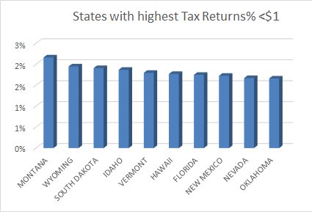
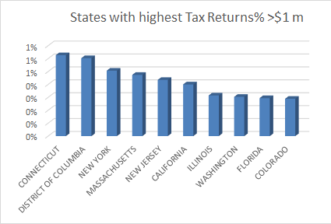
States with Tax Returns <$1 and >$1m
Notes:
One of the requested pieces of information that didn’t make it into the dashboard was an analysis of the states with the highest <$1 and >$1million tax returns. This is a look at the results of the top 10 in each category.
Conclusions here are that many of these states are farming states who may carry over large losses. And there may be a lot of big businesses or very wealthy private citizens in some of these states who pay both large taxes and take large losses to reduce their tax burden.
Tax returns > $1m - NY, Mass, New Jersey, Cali, Washington - large populations working near major tech companies or containing major metropolitan areas. Lots of coastal states and then Illinois with the Second City and Colorado.

Slide 4
Current State of the States:
Elderly
23.8% of all tax filers are classified as Elderly
Only 4.5% of all Elderly tax returns are being prepared/submitted by Tax Counseling for the Elderly (TCE) programs
States with the highest % of Elderly tax returns NOT being prepared by TCE
Louisiana, Mississippi, South Carolina
Notes:
Here is a map showing the states...

Slide 5
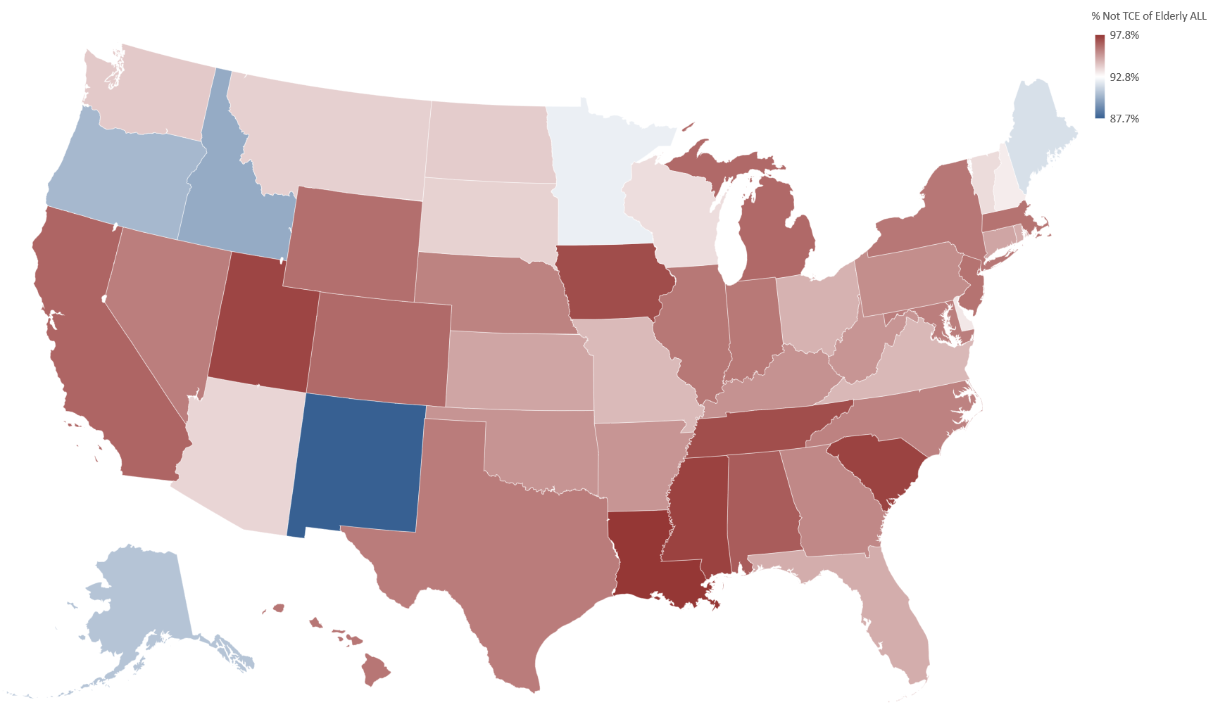
STATES WITH HIGHEST % OF ELDERLY FILERS
NOT RECEIVING TAX PREP
Notes:
Louisiana, South Carolina, Mississippi, Iowa, Utah

Slide 6
Current State of the States:
Low Income
35.5% of all tax filers are in the $1-$25,000 Adjusted Gross Income (AGI) range → “Low Income”
14.0% in the $1-$10,000 AGI range
21.5% in the $10,000-$25,000 AGI range
We excluded <$1 AGI tax filers
States with the highest % of low AGI tax filers
Mississippi, New Mexico, Louisiana
Notes:
Here’s a graph that shows the states...

Slide 7
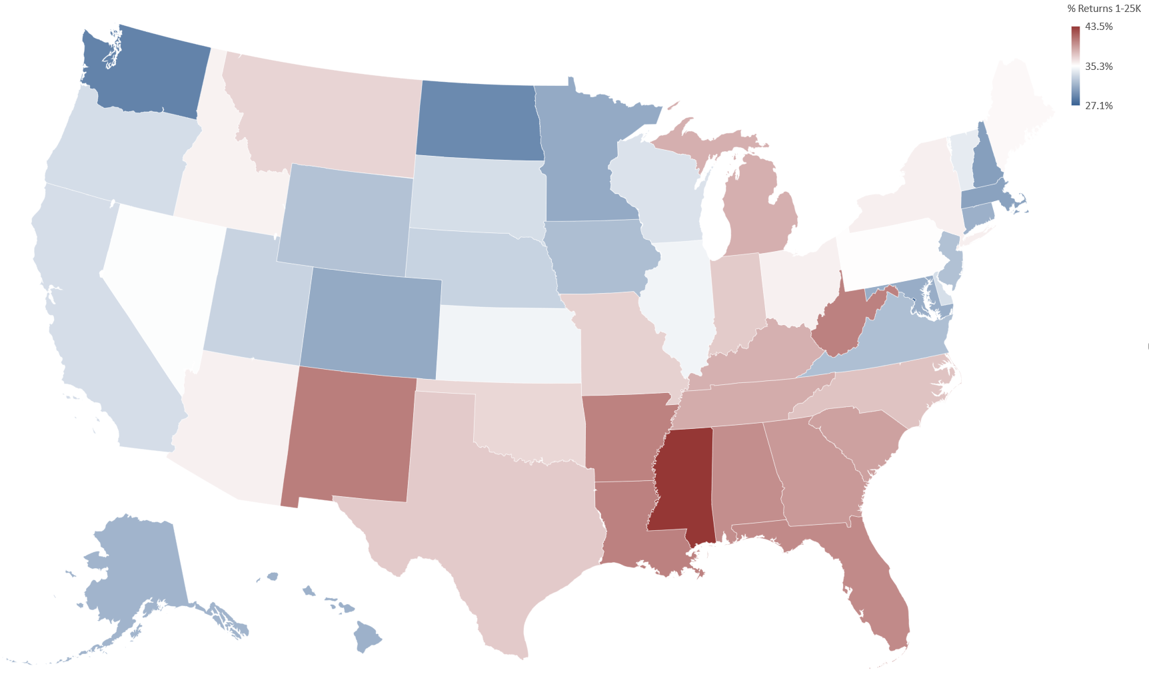
STATES WITH HIGHEST % OF LOW INCOME TAX FILERS
Notes:
Mississippi, New Mexico, Louisiana, West Virginia, Arkansas

Slide 8
Current State of the States: Low Income Volunteer Tax Prep
3.8% of low Adjusted Gross Income (AGI) tax returns are being prepared by volunteers
That means 96.2% of Low AGI tax returns are NOT being prepared by volunteers
States with the highest % of low AGI tax returns NOT being prepared by volunteers
Georgia, Nevada, Mississippi
Notes:
Here is a map showing these states...

Slide 9
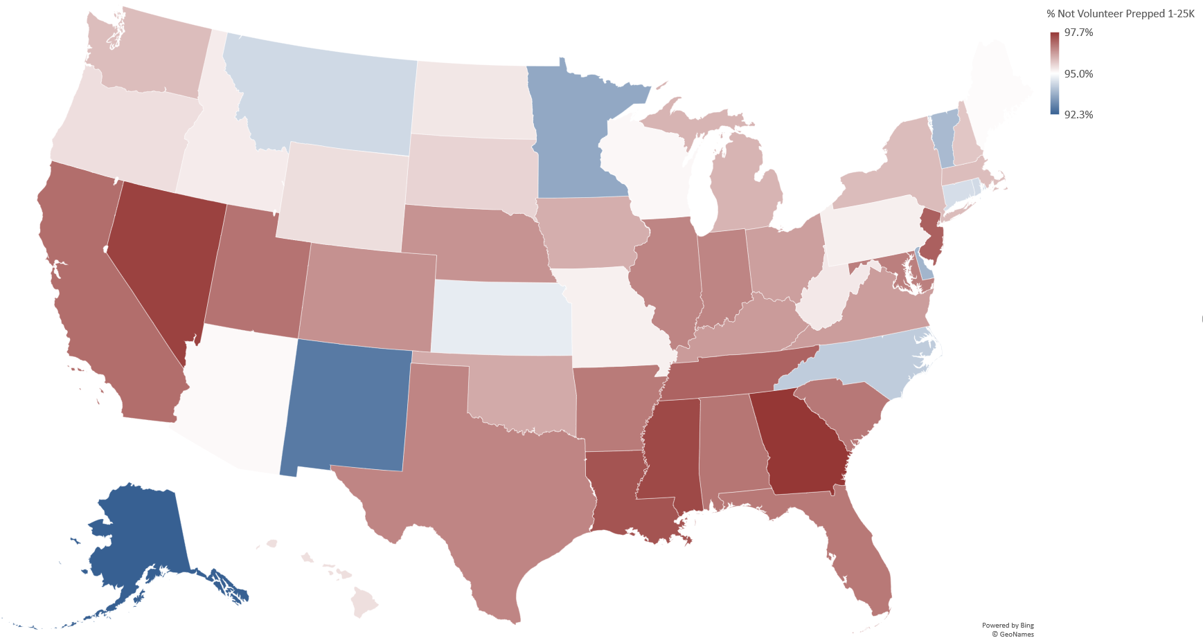
STATES WITH HIGHEST % OF LOW INCOME FILERS
NOT RECEIVING TAX PREP
Notes:
Georgia, Nevada, Mississippi, New Jersey, Louisiana

Slide 10
How will our dashboard help you?
Focus on states of low income and elderly taxpayers
Allows comparison of state income tax demographics to national income tax demographics by: - Elderly Returns - Active/Passive Income by Income Bracket
Helps decision maker understand a state’s position in overall: - Tax Liability
Notes:
The previous slides were to give an idea of how we felt Hands Up America might be able to identify growth opportunities but they aren’t included in the dashboard due to the large number of requirements already set by the Board. However, these charts could be included in a future work order.
Our dashboard helps the decision maker to focus on low income and elderly taxpayers by providing the information specifically requested. It allows the user to compare a specified state to national demographics in the categories of elderly returns and active/passive income and also conveys a state’s position in national tax liability. And now Teresa will give further details about the charts on our dashboard and their functionality.

